Slide 1
RUNGTA COLLEGE OF DENTAL SCIENCES & RESEARCH
TITLE OF THE TOPIC-
FIXED APPLIANCE
DEPARTMENT OF ORTHODONTICS AND DENTOFACIAL ORTHOPAEDICS

Slide 2
Specific learning Objectives
CORE AREAS | DOMAIN | CATEGORY
DEFINITIONS | AFFECTIVE | DESIRE TO KNOW
ACTIVE COMPONENTS | COGNITIVE | MUST KNOW
PASSIVE COMPONENTS | COGNITIVE | MUST KNOW
EDGEWISE | COGNITIVE | MUST KNOW
BEGG’S | COGNITIVE | NICE TO KNOW

Slide 3
Contents:
DEFINITIONS
ACTIVE COMPONENTS
PASSIVE COMPONENTS
EDGEWISE
BEGG’S
SUMMARY

Slide 4
Orthodontic appliance
DEFINITION:
Orthodontic appliances are corrective and supportive braces, designed and prescribed to treat malocclusions, including crooked, crowded, and protruding teeth that do not fit properly together.

Slide 5
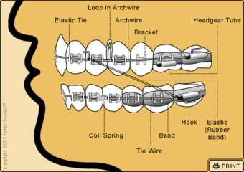
Fixed Appliances:
Definition:
Devices or equipments that are attached to the teeth ,which cannot be removed by the patient and are capable of causing tooth movement.

Slide 6
Components of fixed appliance
Active components Arch wires Springs Elastics separators | Passive components Bands Brackets Buccal tubes Lingual attachments Lock pins Ligature wires

Slide 7
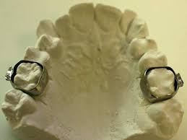
Methods of fixing attachments:
Banding:
Banding involves use of thin stainless steel strips called bands that are pinched tightly around the teeth and then cemented to the teeth.
Bonding:
The method of fixing attachments directly over the enamel using adhesive resins .

Slide 8
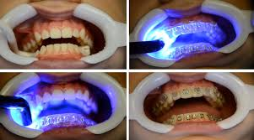
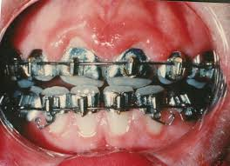

Slide 9
Passive components:
Bands:
Made of soft stainless steel
They are available in various sizes to suit different teeth.
The attachments like molar tubes and brackets are soldered or welded over these bands, which are cemented in position around the teeth.
Comfortable for the patients.

Slide 10
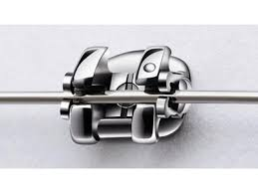
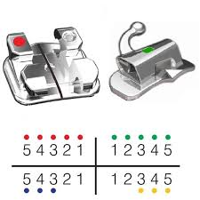
Brackets:
Brackets act as handles to transmit the force from the active components to the teeth.
Brackets have one or more slots that accepts the arch wires.

Slide 11
Types of brackets:
Edge wise type
Ribbon arch
Weldable and bondable
Metallic
Ceramic
plastic

Slide 12
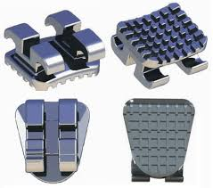
Edgewise type:
Horizontal slot facing labially .
Rectangular slot are so called because they accept wires of rectangular cross section with the larger dimension being horizontal.
Greater control over tooth movement
Do not permit tipping of teeth.

Slide 13
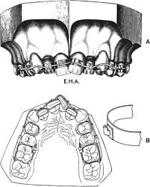
Ribbon arch brackets:
Posses a vertical slot facing occlusal or gingival direction.
Used with round wires to bring about tipping movement of teeth in labio lingual as well as mesio distal direction
Used in begg fixed appliance.

Slide 14
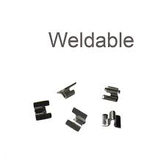
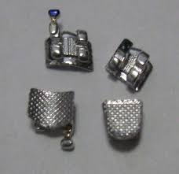
Weldable and bondable:
Bonded directly over the enamel .are bonded brackets
Weldable brackets have a metal flange that can be welded to the band.

Slide 15
Metallic brackets:
These are steel brackets.
Advantages:
They can be recycled
They resist deformation and fractures
Exhibit least friction at the wire bracket interface.
Not very expensive
Disadvantages:
esthetically not pleasing.
Can erode and cause staining of teeth.

Slide 16
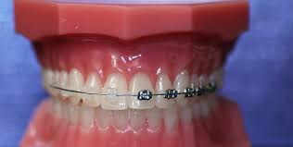
Ceramic brackets:
Made of aluminium oxide or zirconium oxide.
Advantages:
Dimensionally stable and do not distort in the oral cavity.
Durable and resists staining .
Disadvantages:
Very brittle, gets cracked when undue forces are applied.
Exhibit greater friction at the wire bracket interface than metallic brackets.

Slide 17
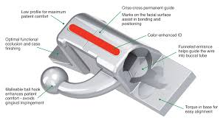
Buccal tubes:
The attachment that is generally used on molars.
It can be weldable or bondable.
Can be round or rectangular in cross section.
May sometimes have double or triple tubes.

Slide 18
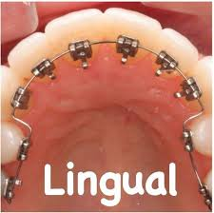
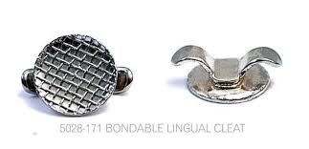
Lingual attachments:
Attachments which are fixed on lingual aspect are called lingual attachments.
Usually required for engaging elastics.

Slide 19
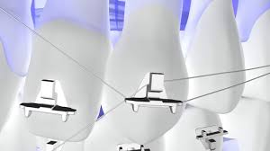
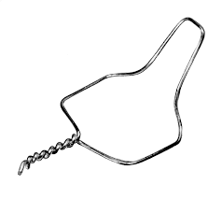
Ligature wires:
They are soft stainless steel wires of 0.009 to 0.011 inches diameter and are used to secure the arch wires to the brackets.
The process of securing the arch wire to the bracket is called ligation
Ligation is usually necessary in edge wise type of bracket that have a labially facing slot.

Slide 20
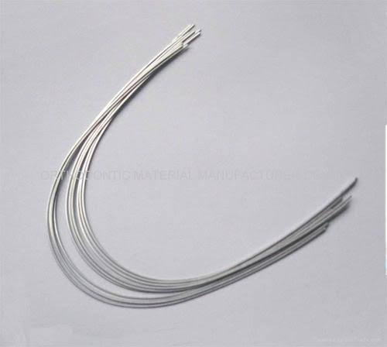
Active components:
Arch wires:
They bring about various tooth movement through the medium of brackets and buccal tubes,which act as handles to the teeth.

Slide 22
Ideal requirements:
SPRING BACK:
It is the measure of how far a wire can be deflected without forming permanent deformation.
A wire should posses high spring back which results in an increase in its range of action.
stiffness:
Presence of low stiffness provide the ability to apply lower forces and a more constant force over time.

Slide 23
formability:
The orthodontic arch wire material should exhibit high formability so as to bend the arch wire into desired configuration such as coils, loops, etc., without fracturing the wire.
RESILIENCE :
Resilience is the amount of force the wire can withstand before permanent deformation. Arch wires should exhibit high resilience so as to increase the working range of the appliance.

Slide 24
Joinability:
BIOCOMPATILITY And environment stability :
Orthodontic arch wires should exhibit resistance to tarnish and corrosion and should be non-toxic. The material should maintain should its desirable properties for extended periods of time after manufacture
.
The wires should be ammendable to welding and soldering.

Slide 25
Elastics:
Made up of latex
Force applied by these elastics depend upon their diameter
Used for closure of space to correct open bites, treatment of cross bite, and to correct inter arch relationship.

Slide 26
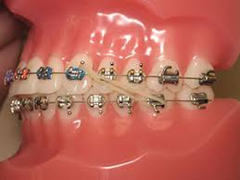
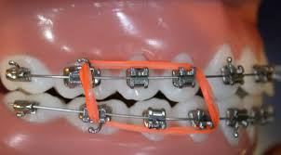
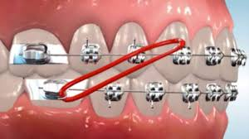
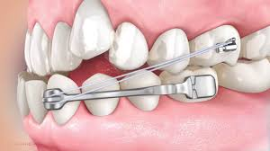

Slide 27
Types of elastics:
Class I elastics:
They are intra arch elastics stretched between the molars and the anteriors.
They are generally used for closure of space, and retraction of teeth.
Class II elastics:
they are intermaxillary elastics stretched between the lower molars and not the upper anteriors.
Used in the treatment of Class II malocclusions
Bring about reduction of upper anterior proclination and mesial movement of lower molars.

Slide 28
Class iii elastics:
They are intermaxillary elastics that are stretched between the upper molars and the lower anteriors.
Used in treatment of Class III malocclusion to bring about mesial movement of upper buccal teeth and retraction of lower anteriors.

Slide 29
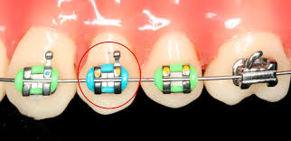
Elastic module:
Made of two elastic rings separated by a variable distance.
Used to close space and for the detoriation of the teeth.
LIGATING RINGS:
Arch wires can be secured to the bracket using small elastomeric rings called ligating rings
Alternate way to secure the arch wire to the brackets is the use of ligature wires.

Slide 30
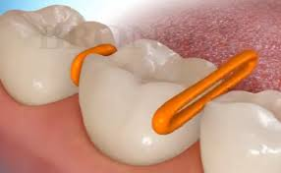
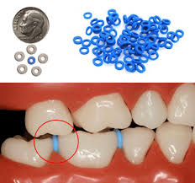
Separators:
Separators or spacers are rubber bands or metal appliances .
These are placed between the molars at the second orthodontic appointment before molar bands are applied.

Slide 31
Types of separators:
Brass wire separators Ring separators Dumbbell separators Kesling’s separators

Slide 32
Kesling’s spring separators:
This is a spring separator that effectively separates the contact.
Spring consists of a coil and two arms.the shorter arm of the spring is passed below the contact while the longer arm rests above the contact.
When the spring is placed in the position the coil opens up thus activating the spring
As the two arms try to come back to position they break the contact.

Slide 33
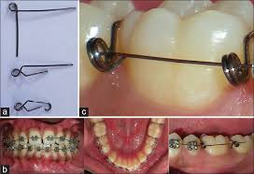
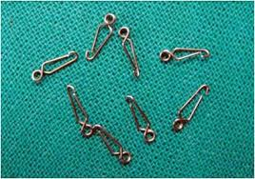
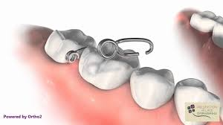

Slide 34
Edgewise appliance:
Angle devised a metal bracket having a rectangular slot of 0.022’’ to 0.028’’dimension.
The wire is inserted into the bracket with the narrow dimension placed occlusogingivally.this mode of insertion of wire is called edge wise technique.
The unique feature of having a rectangular arch wire in a rectangular slot enable control of tooth movement in all the three planes of space.

Slide 35
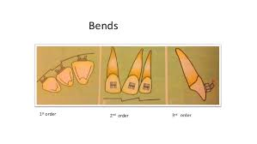
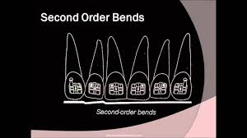

Slide 36
Advantages:
Ability to move teeth in all the three planes of space
Good control over tooth movement.
Bodily tooth movement is possible .
Precise finishing is possible.
Disadvantages:
Need to apply heavy forces.
Complex wire bending
Increased friction between arch wires and the brackets.
Difficulty to open deep bites.

Slide 37
Begg appliance:
Begg modified angle’s ribbon arch technique and introduced the begg light wire differential force technique .
Concept of differential force and tipping of teeth rather than bodily movement.
Begg appliance used high strength stainless steel wires along with the no. of auxillaries and springs to achieve the desired tooth movement.
The treatment using begg appliance is carried out in three different stages.

Slide 38
Stage 1:
It is concerned with alignment, correction of crowding, rotation correction, closure of anterior spaces and achieving an edge to edge anterior bite .
STAGE 2:
the remaining extraction spaces are closed while maintaining the previous corrections that have been achieved .
STAGE 3:
Uprighting and torquing is carried out to achieve normal axial inclination of the teeth.

Slide 39
Advantages:
Use of light forces which are within the physiologic limits
Relatively continous force application
Minimal friction between the wire and the brackets
Rapid alignment and over bite correction.
The appliance does not strain the anchorage .
Extraoral forces are not required to conserve anchorage.

Slide 40
1. Precise Tooth Control Is Possible. 2. Multiple Tooth Movements Are Possible. 3. Patient Cooperation Is Reduced ACTIVE COMPONENTS A. Separators B. Archwires C. Elastics D. Elastomerics E. Springs F. Magnets PASSIVE COMPONENTS A. Bands B. Brackets C. Buccal Tubes D. Lingual Attachments
SUMMARY

Slide 41
REFERENCES
Textbook of Orthodontics – Gurkeerat Singh, Jaypee Brothers; 2nd Edition
Orthodontics – The Art and Science, S.I Bhalajhi, AryaMedi Publishing; 7th Edition
Textbook of Orthodontics – Sridhar Premkumar, Elsevier; 1st Edition
Orthodontics: Diagnosis and Management of Malocclusion and Dentofacial Deformities – O.P Kharbanda, Elsevier; 1st Edition

Slide 42
Question & Answer Session

